Slide 1
TO DO
Finished Domain models
Story boards
Would "Tab" or "Bill" be less confusing than "Order" since the term order can also mean the act of requesting an food-item and the food-item itself?
Full use cases in addition to use case table?
Scope: what's in / out / maybe
Glossary?

Slide 2
Group 3 Capstone Project Presentation 1
Othman Smihi
Charles Hafslund
Mike Utenkov
Fred Arandi
Terry McCarthy

Slide 3
Vision
Restaurants are busy environments and inefficiencies can result in business failure even if the food is great.
Effective coordination of personnel and resources is key to timely service and customer satisfaction.

Slide 4
OrderUp
A restaurant management application used to…
Enter, track, and delegate food and drink orders
Enter and track table statuses
Handle billing
Track inventory

Slide 5
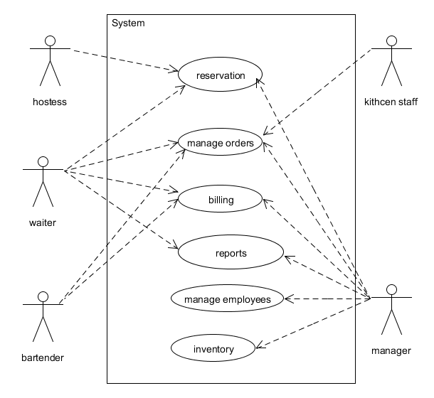
OrderUp

Slide 6
Business Case
Boost business by
Making waiting times smaller and more predictable
Maximizing customer throughput
Maximizing employee efficiency
Increasing customer satisfaction

Slide 7
Actor: Waiter
Goals
Enter customers' orders quickly and easily
Enter customers' orders without errors
Communicate customer orders to the kitchen
Access menu information on demand, as needed
Adjust bill splitting/sharing as needed
Mark what is from each person (seat number)
Take customer payment quickly and easily
See specials
Use coupons / codes
Receive tips
Take complaints

Slide 8
Actor: Kitchen Staff
Goals
View clear and accurate report of queued orders
View upcoming orders in terms of priority
Take ownership of orders
Mark items as completed

Slide 9
Actor: Customer
Goals
Have order recorded accurately
Receive an accurate bill,
including any splitting/sharing arrangements
Pay with a credit card easily and securely
Use coupons / codes
Make a reservation
Lodge a complaint

Slide 10
Actor: Manager
Goals
View aggregated information about sales
View aggregated information about inventory
View aggregated information about employee work
Make adjustments to bill amounts
View complaints
Perform all other roles

Slide 11
Actor: Hostess
Goals
View which tables are open and which are not
View waiting times for tables
via check in and check out, average duration
View which tables may be open soon
See table capacities
View table server assignments
by zone

Slide 12
Actor: Busboy
Goals
Indicate that tables are ready for seating, easily and without error
See which tables need to be cleaned (indicated by bill paid)

Slide 13
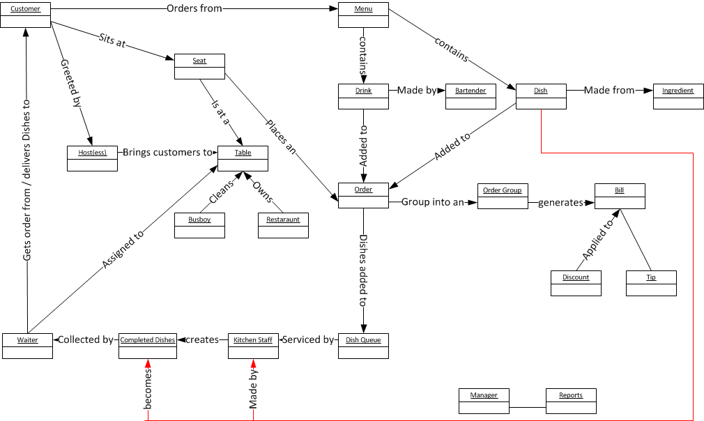
Domain Model

Slide 14
Main Success Scenario
Customer enters
Hostess checks for available tables / estimated wait-time
Customer seated by hostess, table marked occupied and assigned to a waiter
Drinks, Appetizers, meals: ordered /prepared / delivered

Slide 15
Main Success Scenario
Ordering: order-items (drinks and dishes) are added to order-group which is placed in an order-queue by wait-staff
Preparation: order-group is removed from the order-queue by kitchen staff, order-items are prepared (in LPTF order), and the order-group is placed in the delivery-queue. Inventory is updated.
Delivery: item is delivered and removed from delivery-queue by wait-staff.

Slide 16
Main Success Scenario
Queue order is processed by an algorithm that:
Order-groups queued in FIFO
Order-items queued within order-group by longest prep-time first (LPTF) to synchronize their completion

Slide 17
Main Success Scenario
People enjoy food and drinks and possibly order more things.
Meal completed.
Bill is totaled and presented.
Bill and tip can be paid electronically
Bill is designated “settled”

Slide 18
Main Success Scenario
People leave.
Table placed in bus queue
Table is cleaned, removed from bus queue, and marked as available

Slide 19
Use Cases
ID | Name | Scope | Primary Actor | Cmplxity | Priority
1 | Menu view | In | Anyone | Low | 1
2 | Place Order | In | Customer | Low | 1
3 | Deliver Order | In | Waiter | Low | 1
4 | Order review | In | Waiter/customer | Low | 1
5 | Manage Table | In | Waiter | High | 2
6 | Order check off | In | Kitchen staff | Med | 1
7 | Reservation | In | Customer | Med | 2
8 | Item's metadata | In | Anyone | Med | 2
9 | Inventory | In | Manager | Low | 1
10 | Complaint | In | Manager/waiter | Med | 2

Slide 20
Risks / Essential Features
Fast application speed: Do not try customers’ patience.
High reliability: Downtime must be avoided
Credit card PCI information handling
Billing accuracy
Logins securely connect users with their correct role
Effective prioritization algorithm for orders and dishes

Slide 21
Scope: What’s In

Slide 22
Scope: What’s In

Slide 23
Scope: Undecided

Slide 24
Planning: Time
12 weeks
5 people
9 hours / person•week
540 hours total

Slide 25
Planning: Estimated Man-hours
App Design | 140
Mobile App | 120
Web app | 120
Server code | 60
Testing | 50
Database | 25
Graphics/Design | 25

